Slide 1
ActivePure
University of Oregon Recreational Sports Locker Rooms – Environmental Testing

Slide 2
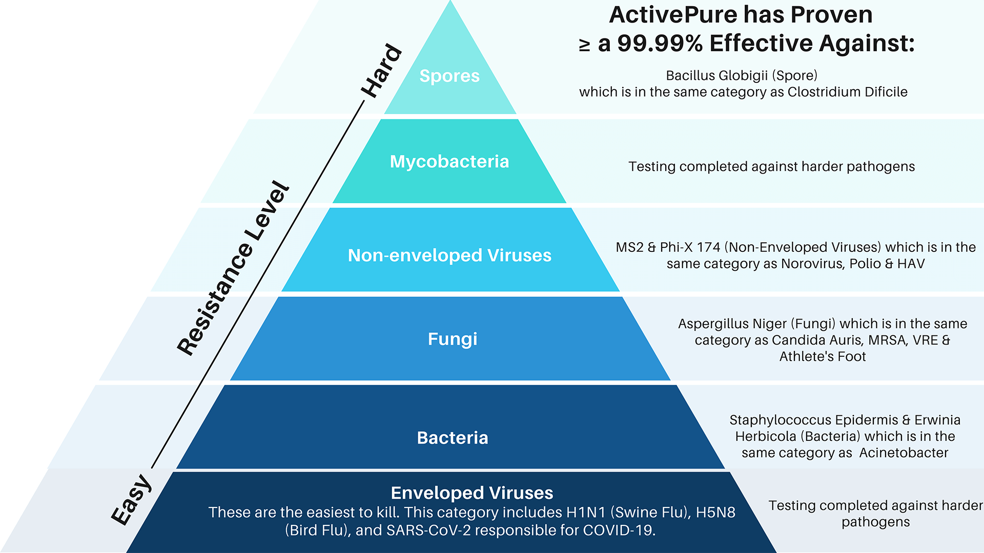
Hierarchy of Pathogens
Testing completed against SARS-CoV-2

Slide 3
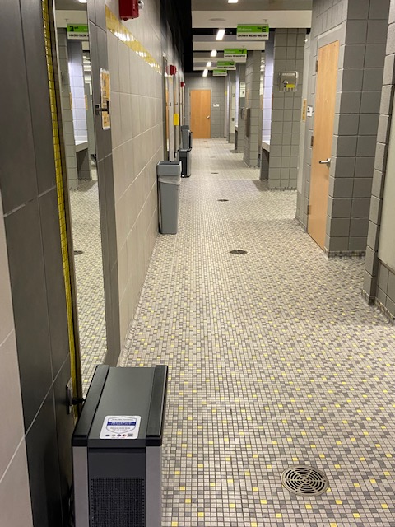
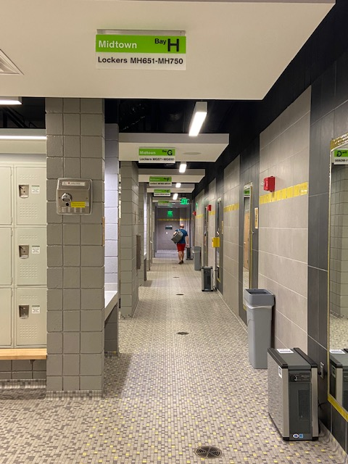
University of Oregon – ActivePure Pilot
Environment Air testing conducted at the University of Oregon Recreational Center Locker Rooms by EHSI Environmental on behalf of ActivePure and the University of Oregon, on the 14th October 2021, re-tested on the 4th November 2021.
The primary mission of this test is to demonstrate efficacy by proxy in inactivating enveloped viruses such as SARs-CoV-2 and the flu.
We demonstrate this by showing a reduction in pathogens like bacteria and fungi, which are both measurable and harder to inactivate than enveloped viruses.
EHSI captured air and surface samples and measured bacteria and fungi growth.
Efficacy in product and design is demonstrated by a reduction in the total Colony Forming Units (CFU’s).

Slide 4
Summary Slide
Total CFU reduction
63.16%
Bacterial CFU reduction
24.8%
Fungal CFU reduction
75.66%
The area tested is a two-story locker room adjoined by a central stairwell. Ground floor doors auto close, and upper floor doors remained open.
Assessments were completed on both male and female locker rooms.
ActivePure Pilot design included induct devices, and portable Beyond Guardian Air installed by Daniel Garstang on the 15th October 2021 to Level 3 standard.
Hand dryers were not in use on first test, however, were being used on second test.
This creates more airborne particles which would have increased the CFU count on second test.

Slide 5
Real World Testing – Before and After Combined - CFU Totals
75.66%

Slide 6
Real World Testing – Before and After - Fungal & Particulates
72.3%
68%
86%

Slide 7
Real World Testing – Fungal & Particulates
Sample Description | Location | Volume (L) | Test 1 - CFU/M3 | Test 2 - CFU/M3
11421-11530-1 | Mid-town Men's 192 | 150 | 760 | 240
101421-11530-2 | Downtown Men's 92 | 150 | 1020 | 140
101421-11530-4 | Downtown Women's 90 | 150 | 1590 | 440

Slide 8
Real World Testing – Before and After - Bacterial Air
71%
27.65%
2.3%
86.95%

Slide 9
Real World Testing – Bacterial Air
Sample Description | Location | Volume (L) | Media | Incubation Temp (C ) | Bacteria Id | Test 1 - CFU/M3 | Test 2 - CFU/M3
101421-11530-B-1 372117928-0001 | Midtown Men's 192 | 141.5 | TSA | 35 | Gram negative rod Gram Positive cocci Total | 21 280 301 | 273 21 294
101421-11530-B-2 372117928-0002 | Downtown Men's 92 | 141.5 | TSA | 35 | Gram negative rod Gram Positive cocci Gram positive rod Total | 7 287 28 322 | 35 0 7 42
101421-11530-B-3 372117928-0003 | Midtown Women's 190 | 141.5 | TSA | 35 | Gram negative rod Gram Positive cocci Total | 7 140 147 | 105 147 252
101421-11530-B-4 372117928-0004 | Downtown Women's 90 | 141.5 | TSA | 35 | Gram negative rod Gram Positive cocci Total | 14 315 329 | 126 112 238

Slide 10
www.activepure.com

