Slide 1

Digital Story Making

Slide 2

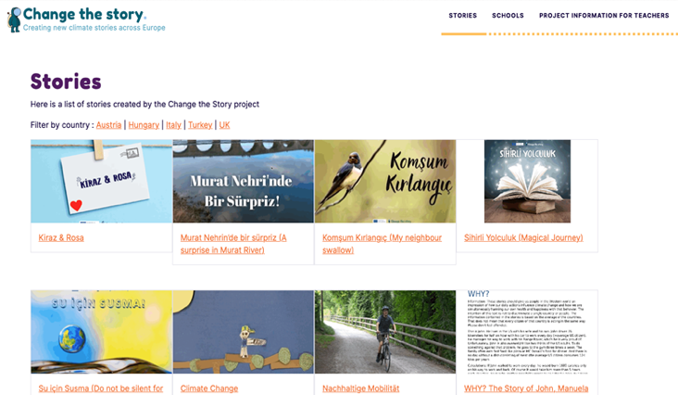
What is Digital Story making?
Digital storytelling is a way of telling stories using technology that brings together one or multiple different digital elements (video, audio, or various forms of written or visual content) to make a compelling narrative.
Found at: https://stories.changethestory.eu

Slide 3

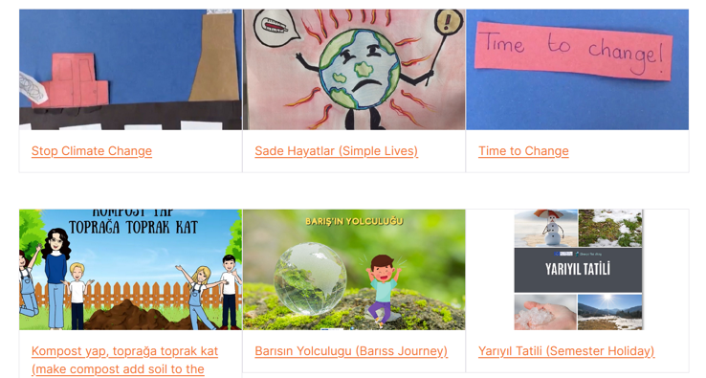
Multiple skills in multiple literacies
Digital storytelling enables pupils to draw together many areas of the curriculum, acquiring many new skills along the way.
Under the umbrella of Environmental Education, Change the Story encourages pupils to interpret what they have learned in Science, History and Geography through the medium of English, Technology, Art and Design.
Found at: https://stories.changethestory.eu

Slide 4
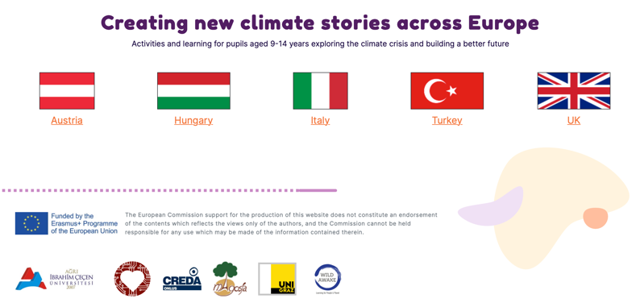
Making a digital story is not essential in order for you to demonstrate what your pupils have learned from the course.
If you do choose to make digital stories, however, your pupils will probably find the experience very rewarding, and empowering, as it enables them to showcase their ideas to a global audience.
Found at: https://www.changethestory.eu
Using technology effectively requires planning, so if you do intend to make some digital stories it’s important to start preparing from the very start.

Slide 5
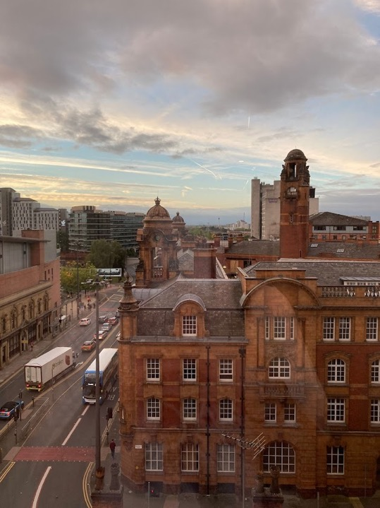
Planning
First, take stock of the devices available to you.
If you have access to a tablet you have access to a wide range of tools and, therefore, a wide range of formats including stop motion animation and comic strip.
If your devices consist of a laptop and the school digital camera then you will probably be working in PowerPoint, Publisher, Word or Movie Maker.
Credit: F.D., 2022
Whatever your devices are, create the story first and then choose your tools.

Slide 6
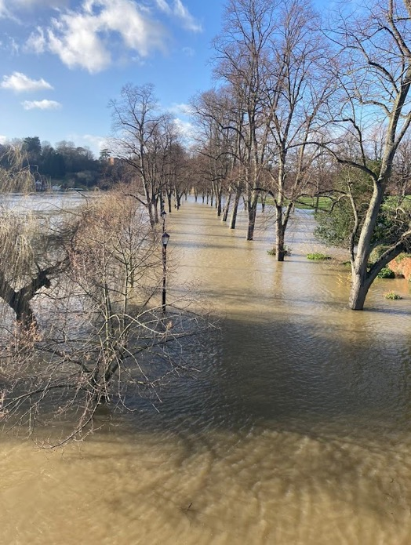
Start collecting resources straight away
Instill the idea of building a gallery right from the very start of the project.
The Gallery could be images and videos taken by the teacher or pupils or parents (avoid people, or any identifiable features, unless written permission is given in accordance with the school’s policies).
Credit: F.D., 2022

Slide 7
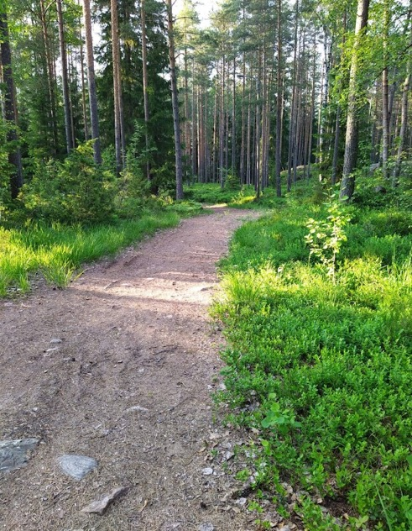
Think about Copyright from the start
Remember that anything associated with the project (drawings or models you make as part of your learning, or images of places visited on trips) are often suitable to photograph and use as resources in The Gallery, as long as you have followed school policies, you had permission to photograph, and you own the copyright.
Credit: F.D., 2022

Slide 8
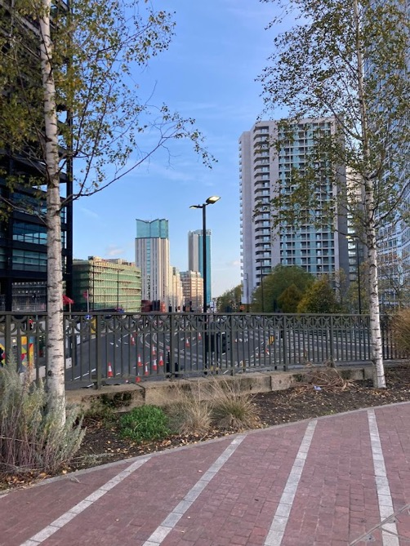
The Gallery
Is a resource centre.
The images and videos can be stored and displayed on Padlet, Sharepoint, Google Photos or similar platforms.
All pupils can be encouraged to contribute.
The resources can be assessed for suitability by the pupils themselves at an appointed time each week if you build this into your SOW.
Credit: F.D., 2022

Slide 9
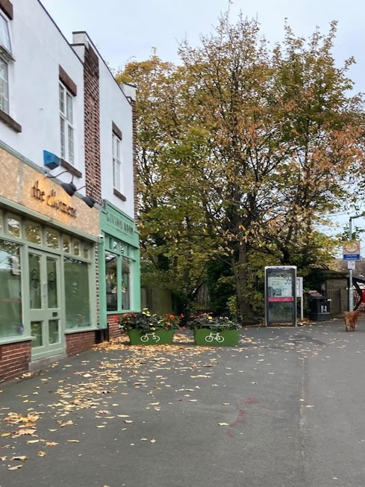
Why is The Gallery important?
It allows the pupils to take and store visual records of all aspects of the course from the beginning (buildings, roads, fields, heavy rain, heatwaves, whatever the change topic is).
It encourages pupils to become attuned to looking out for photo and video opportunities.
It enables pupils to create their own material without incurring copyright.
Credit: F.D., 2022

Slide 10
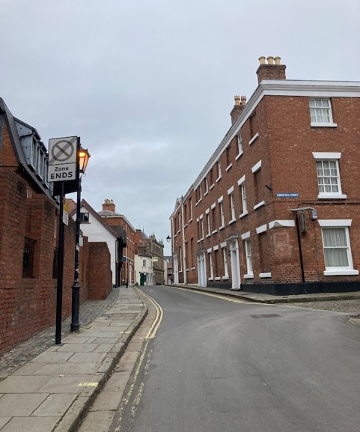
And if you build it into your planning …
It means you can regularly reinforce the importance of e-safety and identity protection.
If you spend 15 minutes a week reviewing new contributions, you should be able to keep checking that the pupils understand what makes a safe resource, and what resources can be used legally.
Credit: F.D., 2022

Slide 11
The Scheme of Work
The Past
The Present
Introduce practical skills for Digital Story making here
The Future
Make the Digital Stories
Aim to begin work on the digital stories about halfway into your scheme of work.
This could be after you have completed the Past and the Present and just as you begin your work on the Future.

Slide 12
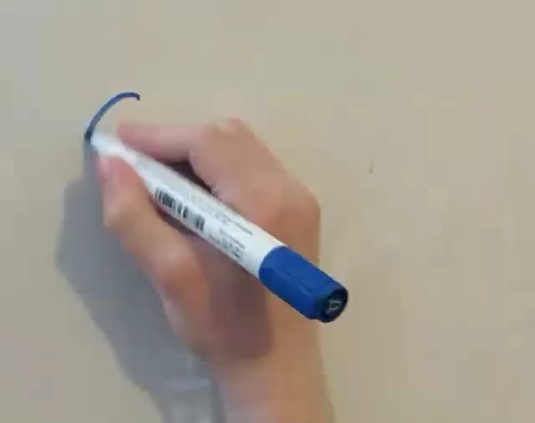
Practice with the technology
Midway through the course, start demonstrating the technology you will be using. If all you have is the school digital camera, you could spend some time demonstrating how to film a hand drawing on a board.
Take the opportunity to remind pupils of e-safety and allow the pupils to become familiar with the equipment.
Credit: H.D., 2022

Slide 13
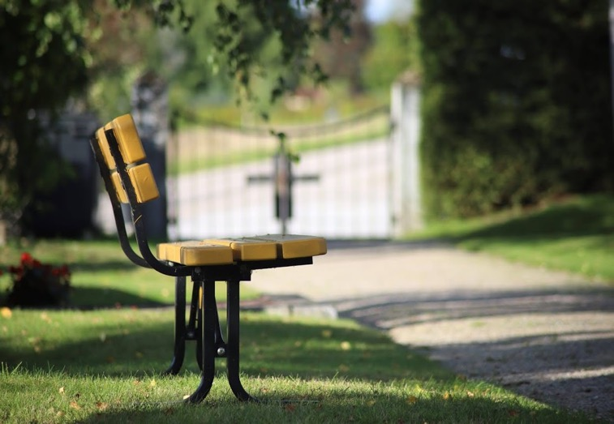
Use everything you can
If you choose to make the model of the future town as part of the Future course, taking pictures of the town from different angles would allow the pupils to develop technical skills and help to build up The Gallery.
Use close-ups, long shots, high angles, low angles and still shots.
Use drawings, text, and transitions.
© Heli Wingate, 2019
If your school digital camera can record, remember you can also speed up and slow down video.

Slide 14
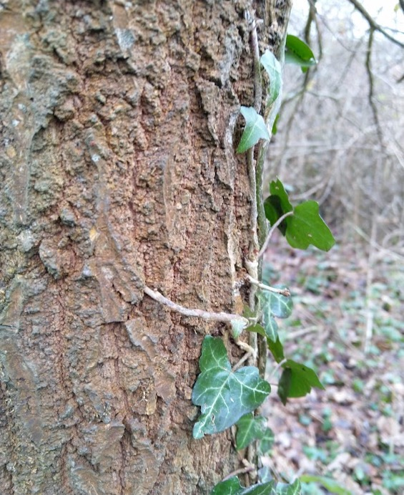
Using Credits
Remember to credit the pictures used.
No full names for a child: Credit: C.D., 2022
Adult with permission: © Carolyn Drever, 2022
And it’s good practice to add Alt Text (for people who are visually impaired).
Alt Text in Powerpoint: click right, select Edit Alt Text and add a short description of the picture.
© Carolyn Drever, 2022

Slide 15
Data protection: Responsibilities for sharing of content
The Change the Story team provides a public celebration website to showcase the stories created by the pupils involved in the project. We’d strongly encourage you to share your stories – but please be aware of the associated responsibilities.
If you wish to submit stories to the celebration site, you must complete and sign the CtS Digital Stories Sharing Responsibility document and include this form with any stories you share with the UK project.
Any sharing by the school of its own digital content beyond the formal mechanisms provide by The Change the Story project (e.g. Facebook or YouTube) will be at the school’s own discretion and risk.

Slide 16
Responsibilities for the creation of content
☐ Any images or videos containing identifiable individuals has consent from each of those individuals, or their parent/guardian where appropriate.
☐ Any textual content, including information about who created the stories, does not reveal the full name of individuals.
☐ The content is appropriate for a general audience, including the younger pupils involved in the project.
☐ All elements of the digital stories created within the project respect copyright law. To help ensure that digital stories are designed from the start with copyright in mind, it is best to encourage the use of pupil-generated content, and where existing resources are used, that copyright is carefully checked via a robust mechanism (e.g. Creative Commons).
You are required to tick the boxes and complete: your name, the school’s name, your signature and the date.

Slide 17
Making a good Digital Story
‘Creating a digital story is not about the technology, but about how well the elements of the digital story are applied, and the quality of the written story.’ (Robin and McNeil, 2012).
https://www.liverpool.ac.uk/media/livacuk/centre-for-innovation-in-education/staff-guides/digital-storytelling/digital-storytelling.pdf
Course 3 - Future
Step 1. Start with an idea.
Step 2. Think about your audience.
This is where it gets tricky!
Step 3. Write your story.
Step 4. Create a storyboard.
Step 5. Research and gather elements.
Step 6. Build your story.
Step 7. Reflect on your story.

Slide 18
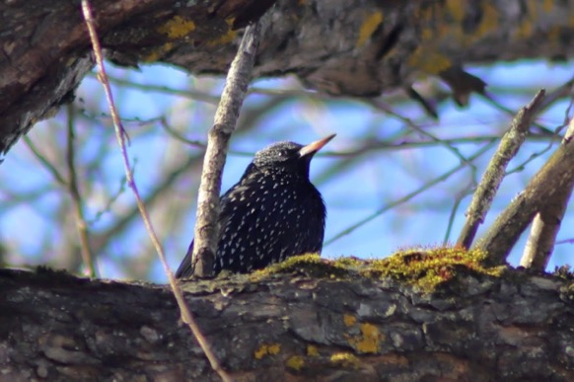
1: Script
Look at all the issues you have covered through the course, pick one that suits you and make a story circle. You begin by describing which topic you are interested in:
‘My story is about all the wild birds I used to see in the fields and hedgerows when I was young. First, I’ll show you pictures of what birds I saw a lot and then I’ll tell you which ones are now endangered. Why do you think they are endangered? How do you think the environment is different now, compared to when I grew up?’
Using a storyboard template, work with the class to fit your story into six frames.
© Heli Wingate, 2021
Next, ask the class for examples of what climate change stories they would like to tell.

Slide 19
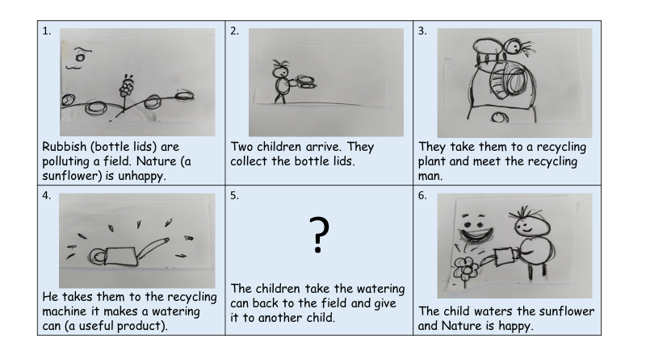
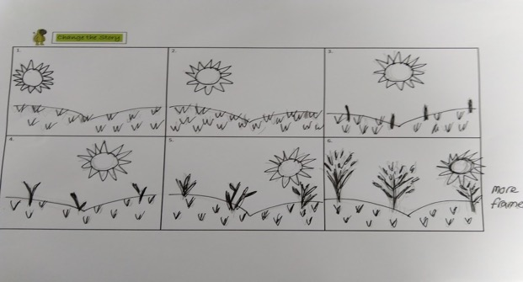
2: Storyboard
After two or three story circles, your pupils should be ready to write their scripts – aim for about 100 - 200 words to begin with.
Once they have a short script they can start to storyboard their ideas.
Take care at this stage, and be prepared for some pupils to need two or three attempts.
Integrate the script into the storyboard – this way you can see which stories might struggle.
© Carolyn Drever, 2021
© Carolyn Drever, 2021

Slide 20
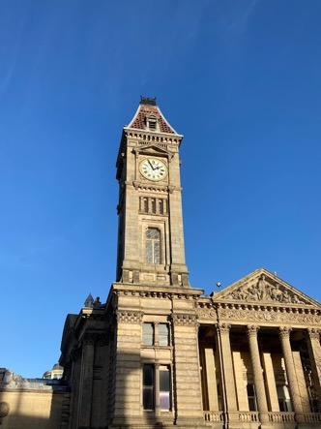
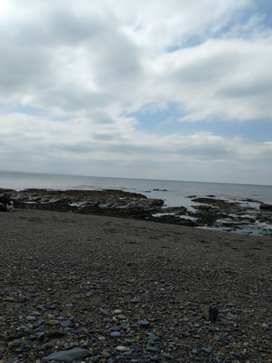
3: Resources: Digital
Use The Gallery to help you gather your digital resources.
Always try to use original material to avoid copyright.
If you use resources from the Creative Commons, see licensing instructions at: Teacher Support – digital story making https://www.changethestory.eu/uk/.
The same goes for websites such as Unsplash, iStock, Pexels etc.
Credit: F.D., 2022
Credit: F.D., 2022

Slide 21
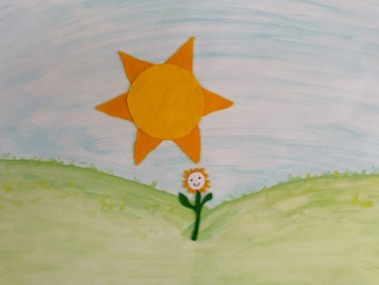
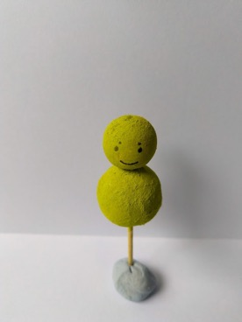
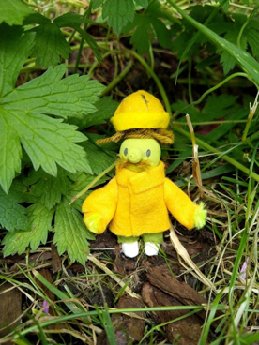
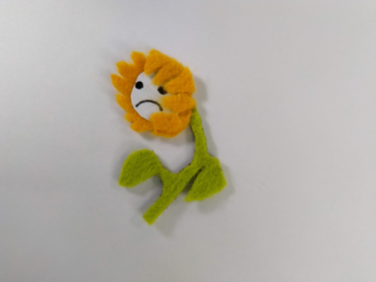
4: Resources: Physical
Incorporate Design Technology and Art into your SOW.
Collect or make props.
Draw or paint backdrops.
Instructions for making models are found at: Teacher Support – digital story making – Presentation for a Stop Motion Animation Workshop for a UK primary school https://www.changethestory.eu/uk/
Credit: B.B. and A.D., 2021

Slide 22
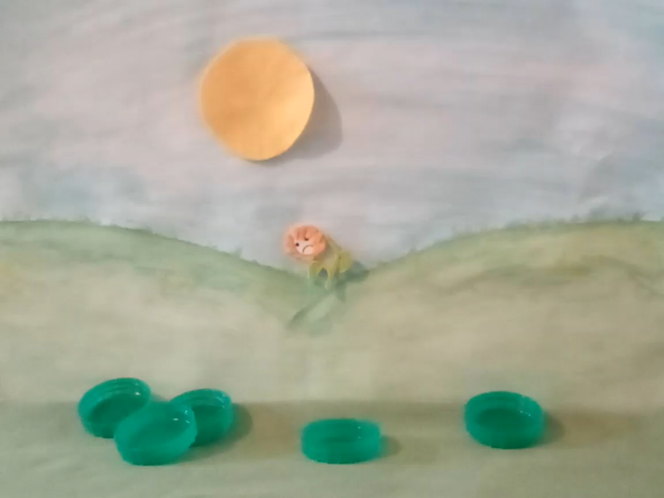
5: Record
We used an Amazon Fire tablet and learned that you need AT LEAST two people – one to film and one to move objects. Five frames make one second and a five second film is 25 frames and that takes about five minutes to make.
See recording instructions for Amazon Fire tablet at: Teacher Support – digital story making – Instructions for pupils on using an Amazon Fire tablet for stop motion animation https://www.changethestory.eu/uk/.
Credits: Alfie, Beth, Flora, Henry, 2021

Slide 23
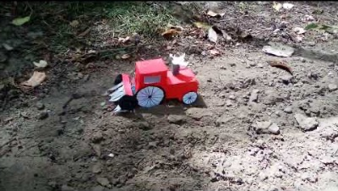
6: Audio
When you are happy with the visuals, record the audio and overlay it.
By audio we mean the narrative and any sound effects.
See adding audio instructions for Amazon Fire tablet at: Teacher Support – digital story making- Instructions for pupils on using an Amazon Fire tablet for stop motion animation https://www.changethestory.eu/uk/
Credits: Beth, Henry, Flora, Alfie, 2021

Slide 24
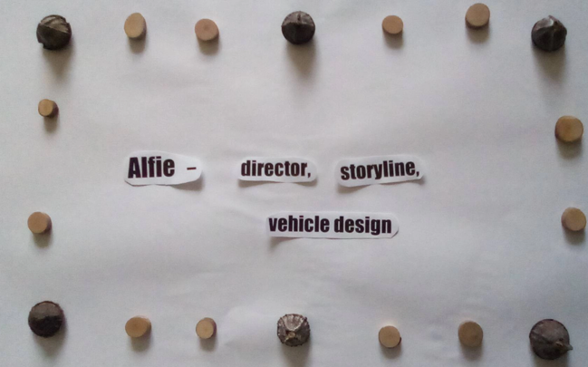
7: Credits
No full names, just first name and role, for example: Props by Beth.
You may wish to credit an adult who helped to create the story, but check you have permission first.
If you have used any apps or websites, please include the links, for example: www.canva.com.
Credits: Beth, Henry, Flora, Alfie, 2021
If you use resources from the Creative Commons, see licensing instructions at: Teacher Support – digital story making https://www.changethestory.eu/uk/.

Slide 25
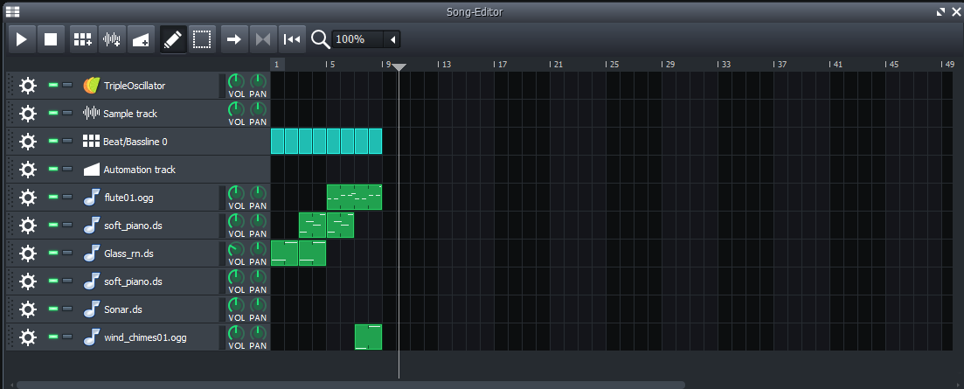
8: Music
You may be able to record music separately and integrate into your digital story.
Or you may need to include it as part of the general audio. (Check your device.)
We recorded the music and narration together in ONE take.
© James Drever, 2022
We made music using LMMS, which is free open-source software.

Slide 26
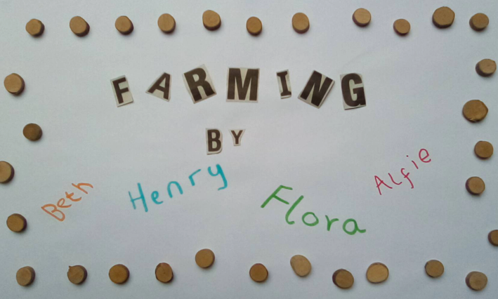
9:Titles
You should be able to insert titles before the main film (check your device).
If this this not possible, you will need to remember to incorporate them before the film - one reason why you need plenty of time for many takes! (See instructions for Amazon Fire tablet at: Teachers Support – digital story making - Instructions for pupils on using an Amazon Fire tablet for stop motion animation https://www.changethestory.eu/uk/.)
Credits: Beth, Henry, Flora, Alfie, 2021
You may also be able to add transitions and effects (check your device).

Slide 27
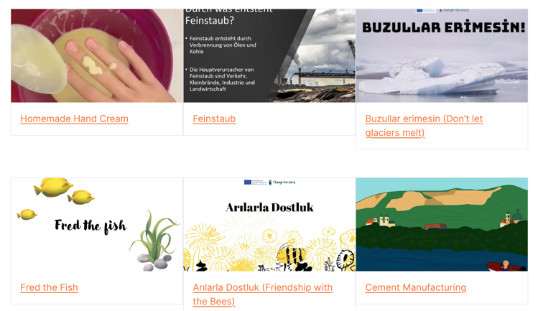
10: Publish
Full instructions will be provided, but here is a simple checklist:
Double check data protection and permissions according to the school’s policies.
Double check you have not used copyrighted material.
Make sure you have credited images and videos wherever you can.
Send your stories to Careful Digital with the signed permissions document.
Found at: https://stories.changethestory.eu
The Change the Story project team will view each story and contact you if it there are any concerns.

Slide 28
More information
You can find more information on making digital stories at:
https://www.liverpool.ac.uk/media/livacuk/centre-for-innovation-in-education/staff-guides/digital-storytelling/digital-storytelling.pdf
https://samanthamorra.com/2013/06/05/edudemic-article-on-digital-storytelling/

